Slide 1
E- Commerce Customer Activation and Retention
By:
Akanksha Padhye

Slide 2
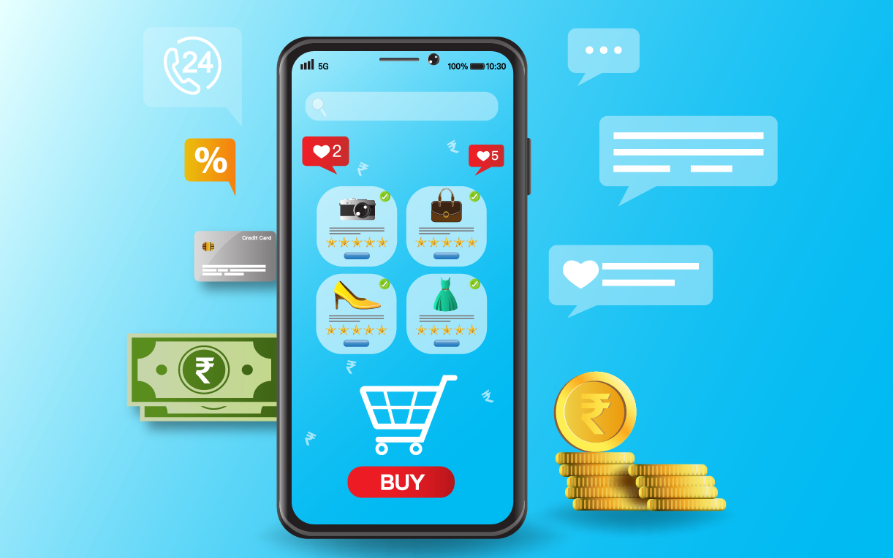
Introduction
The rapid growth of e-commerce, which is a result of the remarkable advancement of the Internet and technology, presents a new paradigm for conducting business worldwide.
Online shopping has become one of the main channels of shopping due to its advantages like:
1) Availability of variety of services and products according to preferences.
2) Convenience
3) Round the clock availability,
4) Flexible pricings and discounts
5) Free door step delivery

Slide 3
Problem Statement:
Customer satisfaction has emerged as one of the most important factors that guarantee the success of online store; it has been posited as a key stimulant of purchase, repurchase intentions and customer loyalty. A comprehensive review of the literature, theories and models have been carried out to propose the models for customer activation and customer retention. Five major factors that contributed to the success of an e-commerce store have been identified as: service quality, system quality, information quality, trust and net benefit. The research furthermore investigated the factors that influence the online customers repeat purchase intention. The combination of both utilitarian value and hedonistic values are needed to affect the repeat purchase intention (loyalty) positively. The data is collected from the Indian online shoppers. Results indicate the e-retail success factors, which are very much critical for customer satisfaction.

Slide 4
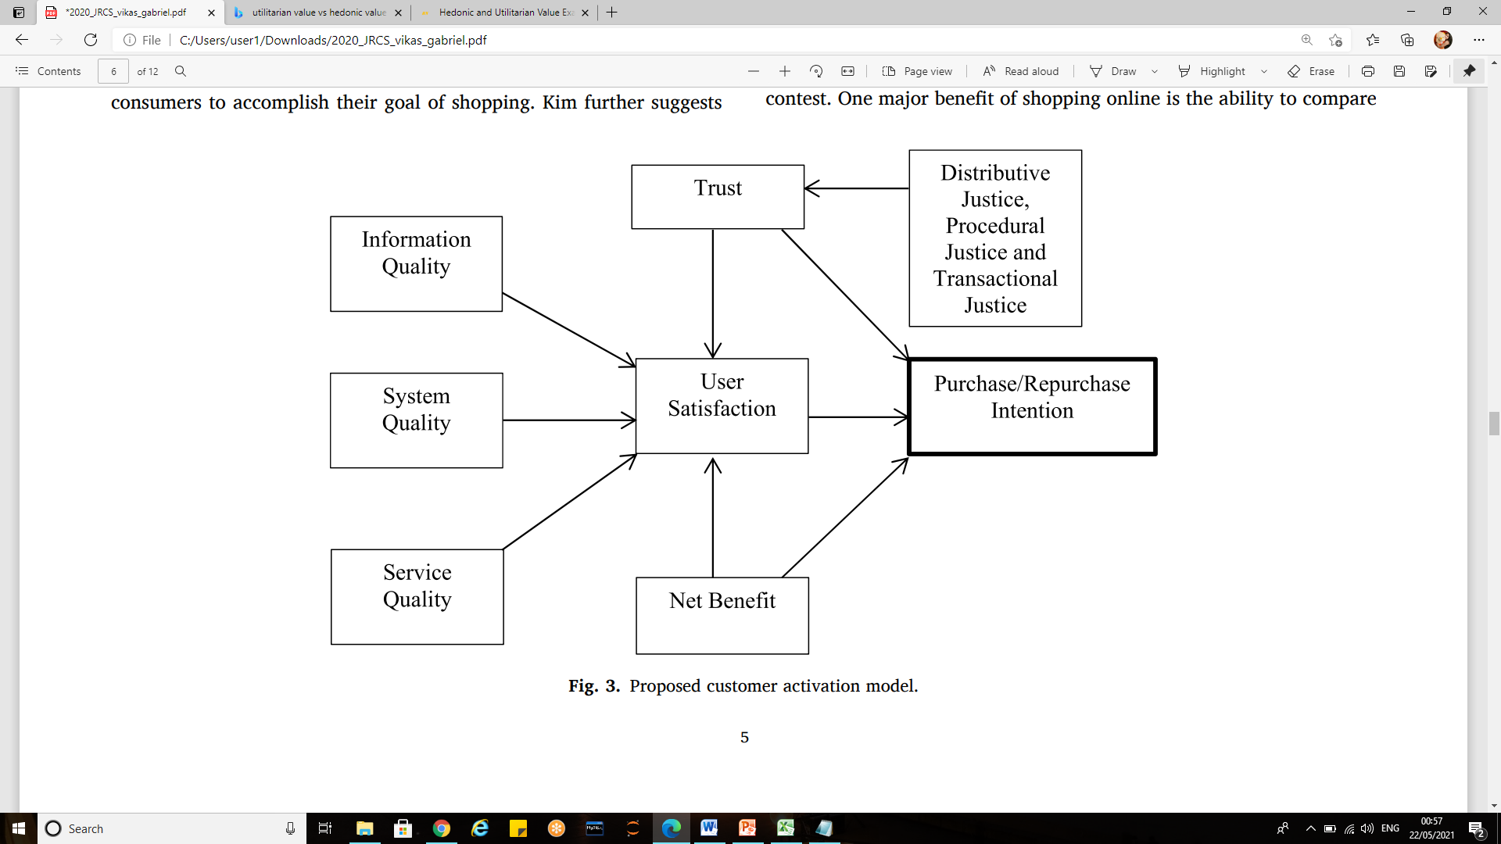
Customer activation model
The model adopts 3 qualities:
System Quality
Information Quality
Service Quality

Slide 5
Understanding customer activation model
User satisfaction: It is defined as a personal feeling of contentment or pleasure, as a result of comparing the actual outcome of shopping online as against their expectation Satisfaction of online customers will positively impact their future intention (repeat purchase) directly or indirectly.
Net benefits :This is used to describe the total benefits received while shopping online as against the costs (for example, effort, money and time).
Trust : This is the perception of a consumer that the merchant will transact with all ethically, capability, and efficient standard. trust produces a positive feelings toward the online retailers; this increases the chances of customer’s intention to buy a products, or use a service.
Purchase/repurchase intention : It can be defined as the likelihood that an online customer is going to buy a product and continue to purchase products from the same online retailer.

Slide 6
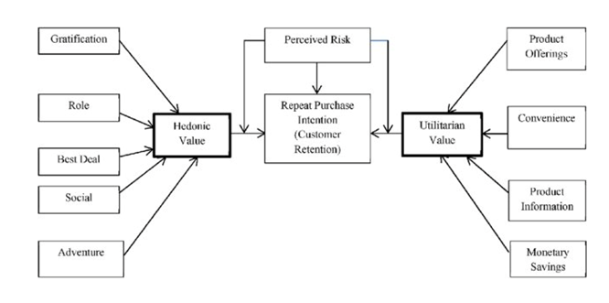
Proposed model for customer retention

Slide 7
Understanding customer retention model
Hedonistic values represent the excitement, and pleasurable experiences derived from shopping online. The hedonic component can be measured by using scales like 'pleasing/annoying', 'happy/sad', 'beautiful/ugly‘.
Utilitarian value is associated with effective, task-specific and economic facets of the products or services. The utilitarian component by using scales like 'valuable/worthless', 'foolish/wise', 'rational/irrational', profit/loss.

Slide 8
Dimension of hedonic values includes:
Role shopping: refers to the online customers who shop to gain pleasure and self-approval when shopping under a different identity to perform a specific role at given time.
Value shopping: One major benefit of shopping online is the ability to compare it observed that pleasure is also derived during the process of browsing for good deal, and listed it as also part of motives of customers shopping online.
Social shopping: reflects the online retail customer propensity to strive for recognition and even friendliness through interpersonal relationships.
Adventure shopping: This type of shopping is engaged in by an online customer who is looking to escape bored therefore requires stimulation to get out of depression.
Gratification: it is a strong motive to shop online; it also improves the chances of buyer returning for a repeat purchase other products from the same e-retailer. It is the degree to which an e-store is entertaining and fun to the online customers.

Slide 9
Dimensions of utilitarian values:
Product offerings: This is described as the complete information on products or services offered for purchase to a customer by an online retailer.
Product information: The information quality of products displayed by an online retailer has to be detailed enough to enhance the customer decision in making a purchase or not.
Monetary savings: one of the major reasons of shopping online is to get value for money, in other words, spend less on products thereby saving more money.
Convenience: Online shopping is very effective because of it convenience, a lot of time and effort is saved when a consumer decides to shop online.
Perceived risk: is an important factor in determining purchase intention, repurchase intention and even to become a loyal customer. Whenever buyers are faced with uncertainty and consequences that are not desirable as a result of a purchase made, they perceive risk.

Slide 10
Exploratory Data Analysis

Slide 11
Dataset:
The dataset has 269 rows and 71 columns
It has no null values
All the features except “pin-code” is object data-type.
There are 177 duplication rows.

Slide 12
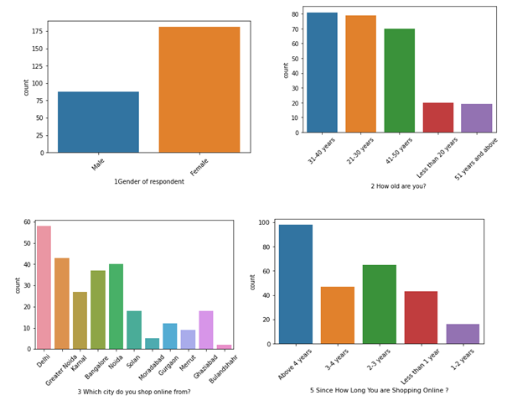
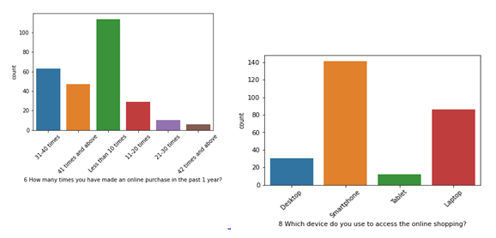
Graphs:

Slide 13
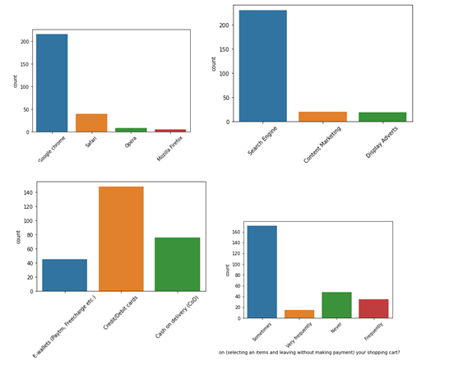
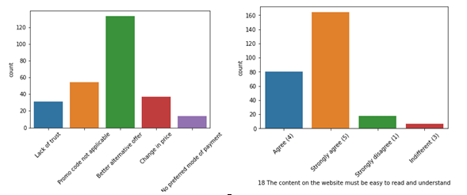

Slide 14
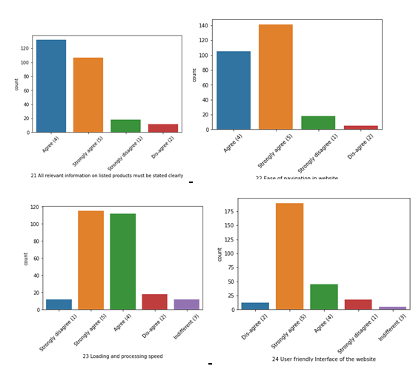
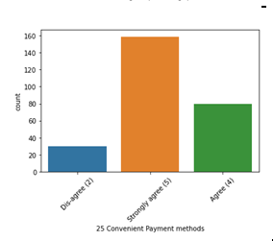
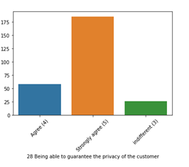

Slide 15
Observations
1. There are more women respondents than men.
2. Amongst the respondents, the major class targetted is between 31-40 years.
3. The respondents are majorly residing in cities like Delhi, Greater Noida, Noida and Bangalore.
4. Majority are shopping online for more than 4 years, followed by people shopping for 2-3 years.
5. We can observe that many have shopped less than 10 times in the past year.
6. Many of them use mobile to shop online and because of it mobile internet is used alot.
7. Google Chrome is majorly used to access the shopping website.
8. People are becoming customers of their favorite stores by using the search engine.
9. For repeated visits, people use search engine first, followed by app and direct URL.
10. Majority of the people spend more than 15 minutes before making a purchase.
11. The major payment method used by all is credit/debit cards, followed by COD and e-wallets.
12. People have mentioned that sometimes they would leave the cart without purchasing and the major reason they have mentioned is that they are finding some better alternative offer.
13. Customers strongly agree that content of website must be easy to read and understandable.
14. Majority of customers want information of similar products to make purchase.
15. Majority of the customers want complete information on listed sellers and their products being offered.
16. Customers want all relevant information on the listed products and very less customers disagree to that.
17. The customers wanted the websites to be easily navigated.

Slide 16
Observations:
18. Majority of the customers wanted high loading and processing speed, user friendly interface of website, convenient payment method, high trust on website, empathy towards customers, guarantee privacy of customers, responsiveness-availability of several communication channels, etc.
19. People feel that online shopping provides monitory benefits and discounts.
20. Customers also feel that shopping online is convenient and flexible.
21. Return policy is important for deciding the product purchase to many customers.
22. Many customers find shopping through online helps them financially because of cost and discount factors.
23. When it comes to certain factors like gratification, social status enhancement because of shopping, or whether shopping online gives a thrill or adventure, customers are more indifferent to these. So, there is an ample scope in giving more enhanced experienced to customers in this regard.
24. Above 41-50 years and less than 20 years, female and male respondents count difference is not much.
25. From Bangalore and Greater Noida, many respondents are female.
26. From Noida and Delhi, many respondents are male.
27. Both men and women shopping from desktop count are almost same. However, more women shop from either smartphone or laptop.
28. Most of the women come back to shopping website by using search engine.
29. Many women prefer to use search engine or app, rather than direct URL. However, men prefer to use search engine and Url and app little less. So we can understand that women use app more than men.
30. Women spend more time than men during online shopping and the time is mostly more than 15 mins

Slide 17
Observations:
31. Women compare the products with other websites and is one of the reasons to leave the cart without shopping.
32. More women disagree that online shopping is a kind of adventure.
33. Women dont feel that online shopping fulfills certain roles.
34. Amazon and flipkart is easy to use as compare to other websites.
35. Amazon and flipkart has great visual appealing as compare to others and then followed by myntra.
36. Wild variety of products on offers are seen on amazon and flipkart.
37. Amazon provides complete and relevant description information of products to their users.
38. Amazon has fast loading speed and then followed by snapdeal and flipkart.
39. Amazon takes longer time to get logged in during promotion, followed by flipkart, paytm and snapdeal.
40. Amazon takes longer time in displaying graphics and photos followed by flipkart and snapdeal.com.
41. Myntra and Paytm makes late declaration of price during promotion.
42. Paytm takes longer time to load the page during promotion.
43. Snapdeal and Amazon have limited mode of payment on most of products during promotion.
44. Paytm and Snapdeal take a longer delivery period, whereas Myntra and Amazon takes lesser delivery period.
45. Amazon, Snapdeal and Myntra have frequent discrepencies, when moving from one page to another.
46. Many customers have shopped from Amazon and Flipkart.

Slide 18
Observations:
47. Paytm and Snapdeal had not been given more marks on availability of wild variety of products.
48. Amazon and Flipkart have got more positive feedbacks than other websites with relevant to Complete, Reliability of website, quickness to complete purchase, availability of several payment options, speedy order delivery, privacy of customers information, security of customer financial information, etc.
49. Paytm has got less feedbacks in perceived trustworthiness, presence of online assistance through multi-channel, speed order delivery.
50. Snapdeal.com has got less number of feedbacks in change of website/application design.
51. Myntra has got the least feedbacks in website as efficient as before, followed by Snapdeal.
52. Many people will recommend amazon and flipkart to others.

Slide 19
Conclusion
This Data is very useful for Indian Online Retailer to sale there Goods.
They can easily target customer with this data.
They can choose Trustworthy Platform to sale their goods.
Also they can understand their customer and make some changes according to customer need.

Slide 20
Thank You

